Slide 1
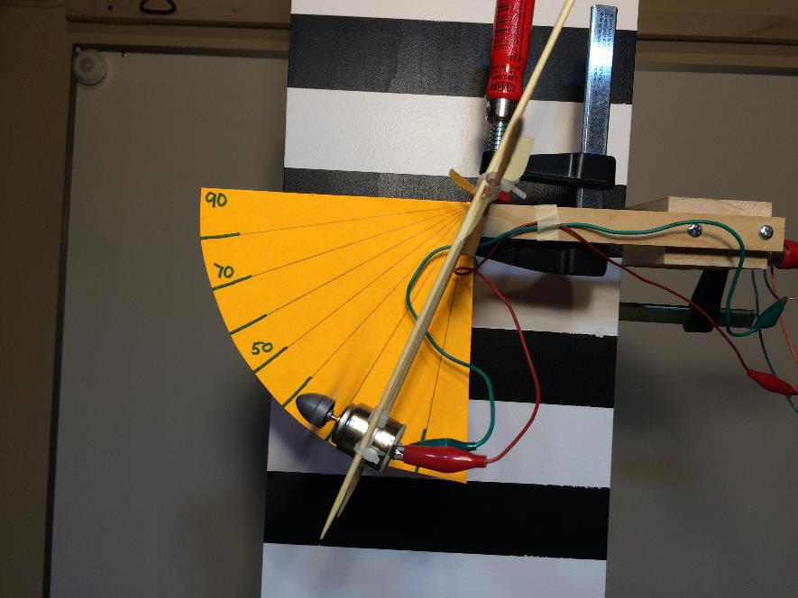
Propellers
Suggested Experiments
LabRat Scientific
March 2018

Slide 2
Exp. 1 – Thrust vs. Propeller Pitch
Scientific Question
How does the pitch of a propeller affect the thrust it produces?
Equipment and Materials
Propeller Test Apparatus
Test Propellers (3-4 different blade pitch angles)
Purchase propellers designed for electric motors, they will tend to have smaller hub holes
Power supply and Volt Meter

Slide 3
Exp. 1 – Thrust vs. Propeller Pitch
Things to consider:
Make sure there is minimal friction at the pivot point
Do the different propellers have essentially the same weight? If not, you will need weight the motor + propeller + wires each time
The motor may not run at the same RPM for a given voltage for each of the propeller pitches (but is might be close enough). Ideally, measure both voltage and current during the tests.
The motor has to work a little harder as the pitch of the blade increases. This will make the motor draw more current.
Maintain a constant “voltage * current” for corresponding steps for each propeller

Slide 4
Exp. 1 – Thrust vs. Propeller Pitch
Approach:
Install the desired propeller
Measure weight of the motor + propeller + appropriate amount of wire
Set up propeller test rig
Run tests and record results
Run motor in 1 VDC increments.
Allow oscillations to damp out before recording deflection angle
Record angle
Increase voltage by 1 VDC, repeat to maximum voltage
Repeat the test at least 5 times and calculate the average forces
Install new propeller and Repeat Steps 3 – 4

Slide 5
Exp. 1 – Thrust vs. Propeller Pitch
Data Analysis
Plot Thrust vs. Voltage for each propeller
Is the data linear for each propeller?
Is the slope of the thrust lines all the same?
Which propeller produces the most thrust?
Do some propellers seem to work better at high or low voltage?
Drawing Conclusions
Which propeller is the overall best
Does data indicate that benefits of blade pitch may taper off as pitch is increased ?

Slide 6
Exp. 2 – Thrust vs. Propeller Diameter
Scientific Question
How does the diameter of a propeller (and thus the area of the actuator disk) affect the thrust it produces?
Equipment and Materials
Propeller Test Apparatus
Test Propellers (3 identical)
Carefully cut the ends off two of the propellers. It is suggested to cut 10% of the length off each blade on Prop #2, and 20% of the length off each blade on Prop #3.
Power supply and Volt Meter

Slide 7
Exp. 2 – Thrust vs. Propeller Diameter
Things to consider:
Make sure you carefully remove identical amounts from each blade to ensure the propeller remains balanced
The propellers will have different weights. Before starting the tests, weigh each of the motor/propeller configurations.
The motor may not run at the same RPM for a given voltage for each of the propeller pitches (but is might be close enough). Ideally, measure both voltage and current during the tests.
The motor has to work a little harder as the pitch of the blade increases. This will make the motor draw more current.
Maintain a constant “voltage * current” for corresponding steps for each propeller

Slide 8
Exp. 2 – Thrust vs. Propeller Diameter
Approach:
Install the desired propeller
Measure weight of the motor + propeller + appropriate amount of wire
Set up propeller test rig
Run tests and record results
Run motor in 1 VDC increments.
Allow oscillations to damp out before recording deflection angle
Record angle
Increase voltage by 1 VDC, repeat to maximum voltage
Repeat the test at least 5 times and calculate the average forces
Install new propeller and Repeat Steps 3 – 4

Slide 9
Exp. 2 – Thrust vs. Propeller Diameter
Data Analysis
Plot Thrust vs. Voltage for each propeller
Is the data linear for each propeller?
Is the slope of the thrust lines all the same?
Which propeller produces the most thrust?
Do some propellers seem to work better at high or low voltage?
Drawing Conclusions
Which propeller is the overall best
Does the data give you a hint when too much reduction in blade length may occur?

